Slide 1

Dual
Enrollment
Webinar
Series

Slide 2
High School Partners know their students and their systems, Columbia knows our programs and classes… let’s help inform each other for the benefit of our shared dually-enrolled students

Slide 3
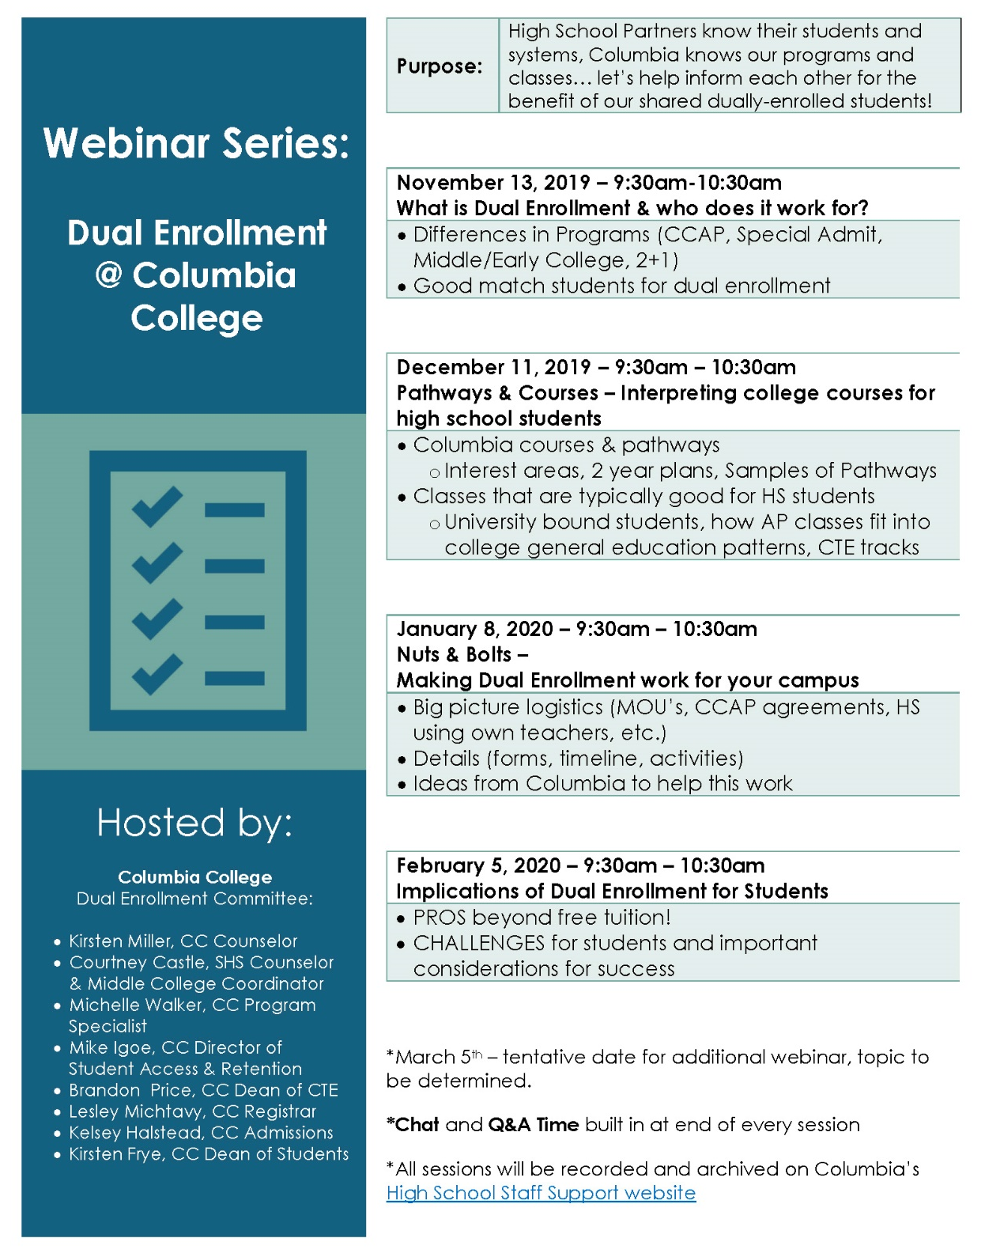
Upcoming Webinar Topics

Slide 4

Today’s Webinar
December 11, 2019
Pathways
& Courses
Interpreting college classes for high school students with Columbia College Counselor, Kirsten Miller & Dual Enrollment Team

Slide 5

What Columbia Offers
40 programs of study
  Career Technical Education
  General Education
  Major courses for university
Career & College readiness classes
Online, face-to-face, hybrid course options
Personal growth/development

Slide 6
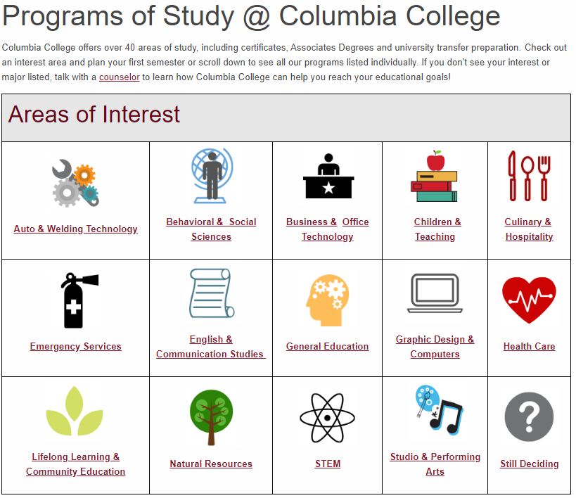

Interest Areas
Similar majors
grouped together
https://www.gocolumbia.edu/counseling/advising_guides.php

Slide 7
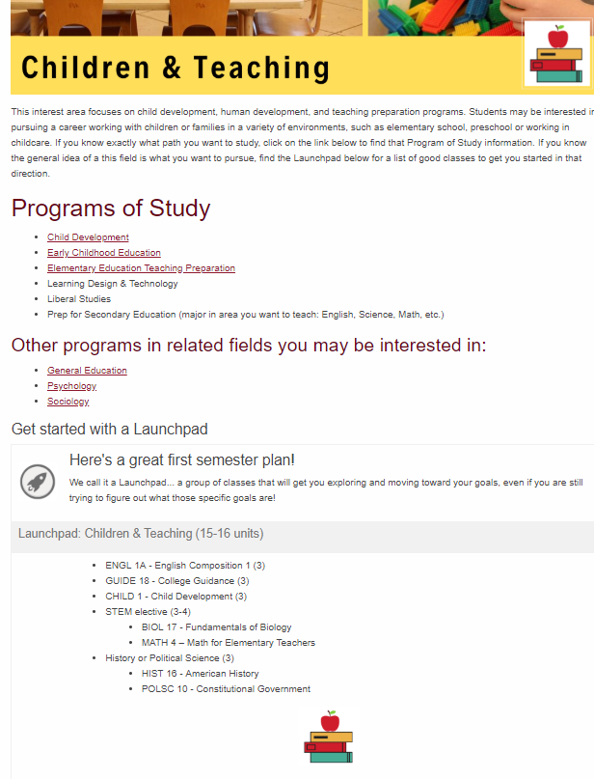
Example of
Programs of Study/
Interest Area page
Programs related to that interest
Other related fields
Launchpads
  12-15 units of good first semester courses to get started in that area, often general education courses aligned with that major area
  A good place to see courses that would be good to start taking in high school toward a major

Slide 8
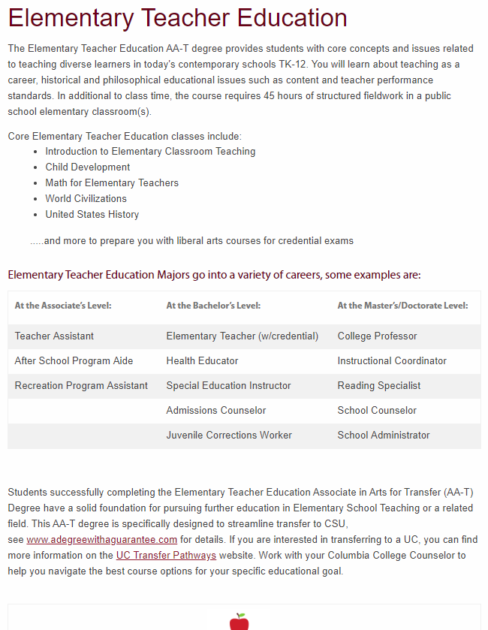
Example of individual
Program of Study page
Core classes
Example careers at different educational levels
Links to pathways at CSU and UC
Some programs also have a 2-year plan for completion (pdf link)

Slide 9


Pick Classes with the student’s GOAL in mind!
High School Graduation
College Preparation
A-G requirements for eligibility to go straight to 4-year
High school graduation requirements
Eligibility for sports in college
Will college courses be weighted in high school GPA?
  High school decision
  Will likely be weighted by colleges regardless of high school decision
Transferable coursework for university–
  Make sure for student goal (UC/CSU)
  General Education requirements
  Course #’s 1-99, i.e.: Engl 1A, Math 2, Music 12
Introductory course work for major
  i.e.: Engineering… take calculus
Courses in an interest area to explore ideas
Skills based courses to help get jobs
  i.e.: Hospitality Management, computers, media
Guidance courses—help with transition to college and career exploration
  i.e.: Guide 18, Guide 1

Slide 10
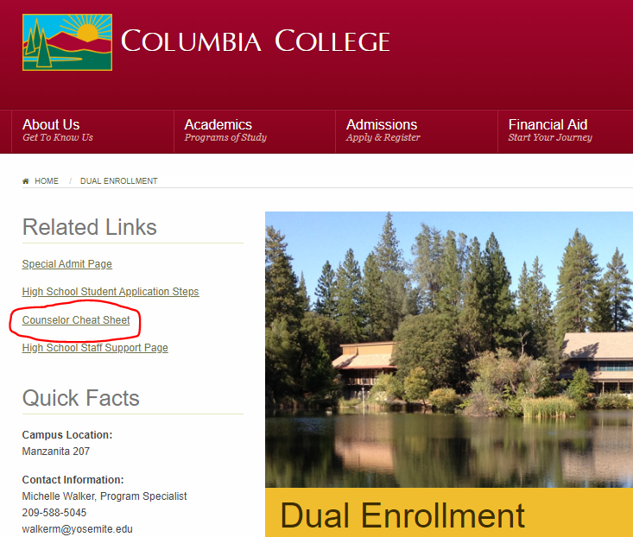
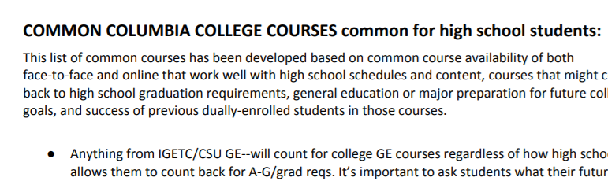
Classes that are good bets for High School Students
Excerpt from Counselor Cheat Sheet, Page 6

Slide 11
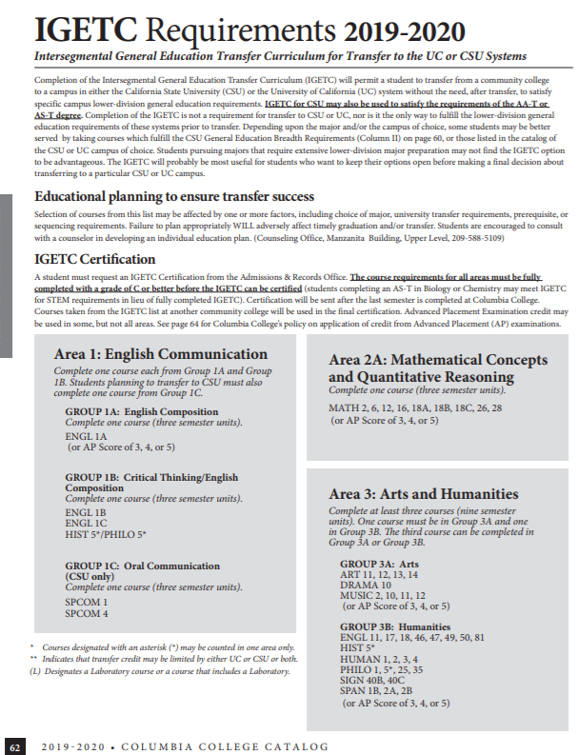
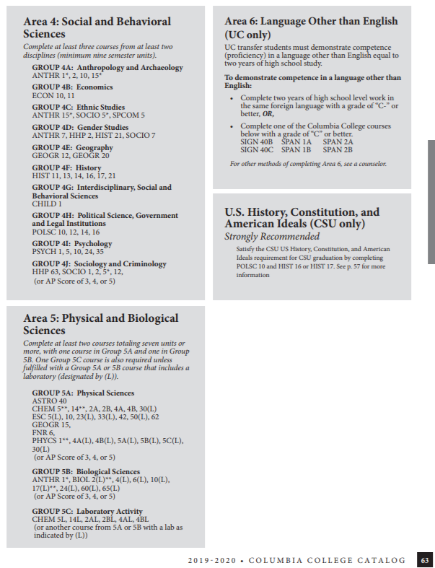

Slide 12
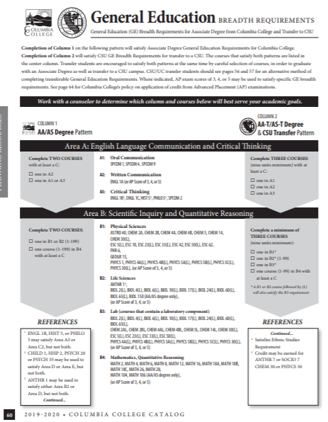
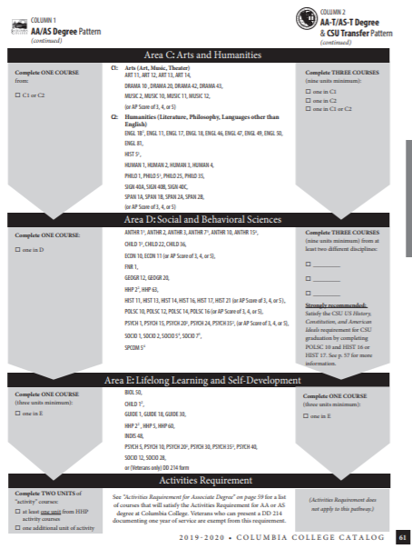

Slide 13
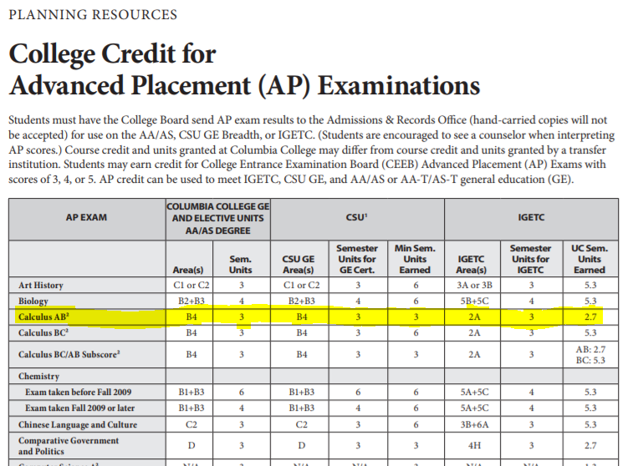
AP classes
& college
Page 61 in CC Catalog
Shows exactly what general education area (in all 3 of our patterns) that a specific AP test score of 3, 4, or 5 will meet
AP tests with 3+ scores will always work for GE. May be different for major courses.
Be sure student is not enrolling in a college class where they are already getting credit

Slide 14
College uses high school transcripts…
For placement into English and Math courses (or a course with those prerequisites)
To clear prerequisites, based on courses taken in high school
Chemistry: an A or B in high school chem will clear our General Chem prereq
Spanish: our 1A is like 2 years of high school Spanish, 1B like year 3 & 4
Others can be challenged with prerequisite challenge form if student competency can be demonstrated
Official College Board transcripts are required for AP credit to be awarded

Slide 15


Class ‘Location’ matters!
FACE-to-FACE:
On campus and off campus locations
  CCAP at high school location, during high school day, with only high school students
Attendance usually necessary for success, but not always graded
Hybrid courses have an in-class component as well as online expectations
ONLINE:
No in-person requirement
Need access to good computer and high speed internet connection
Strong self-motivation and good time management necessary!

Slide 16
Need more?
Call Kirsten Miller or
Courtney Castle (info next slide)
Summary of Links in this presentation:
Dual Enrollment at Columbia College
Counselor Cheat Sheet for High School Dual Enrollment
Columbia College Catalog (GE patterns, AP tests to GE areas)
Columbia College Programs of Study (Interest Areas & Launchpads)

Slide 17

Dual Enrollment Contacts:
Michelle Walker, CC Program Specialist Dual Enrollment
walkerm@yosemite.edu, 209-588-5045
CCAP Questions, paperwork, coordination
Kirsten Miller, CC Counselor
millerk@yosemite.edu, 209-588-2155
Dual enrollment student advising, placement, educational planning
Courtney Castle, SHS Counselor/Middle College Coordinator & CC Adjunct Counselor
ccastle@sonorahs.k12.ca.us, 209-532-5511 Ext 5119
Support for other high schools developing and implementing programs
Mike Igoe, CC Director of Student Access & Retention
igoem@yosemite.edu, 209-588-5236
On boarding (applications, orientation, etc.)
Kelsey Halstead, CC Admissions
halsteadke@yosemite.edu, 209-588-5231
& Lesley Michtavy, CC Registrar
michtavyl@yosemite.edu, 209-588-5232
Transcripts, admissions information, student holds, registration
Kirsten Frye, CC Dean of Students
fryek@yosemite.edu, 209-588-5144
Special petitions, oversees CC Counseling and Outreach programs
Brandon Price, CC Dean of CTE
priceb@yosemite.edu, 209 588-5079
Dual Enrollment Program, faculty hiring, course scheduling

Slide 18

Thank You!

