Slide 1
Dual Enrollment Webinars

Slide 2
High School Partners know their students and their systems, Columbia knows our programs and classes… let’s help inform each other for the benefit of our shared dually-enrolled students

Slide 3
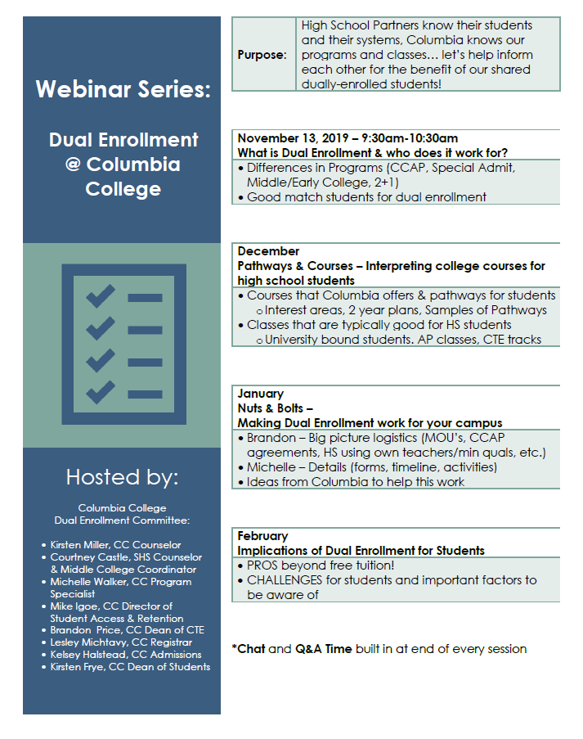
Upcoming Webinar Topics

Slide 4
We have resources available to support your dual enrollment efforts

Slide 5
Dual Enrollment Contacts: Michelle Walker, CC Program Specialist Dual Enrollment — walkerm@yosemite.edu, 209-588-5045 CCAP Questions, paperwork, coordination Kirsten Miller, CC Counselor millerk@yosemite.edu, 209-588-2155 Dual enrollment student advising, placement, educational planning. Courtney Castle, SHS Counselor, Middle College Coordinator, and CC Adjunct Counselor ccastle@sonorahs.k12.ca.us, 209-532-5511 Ext 5119 Support for other high schools developing and implementing programs

Slide 6
Dual Enrollment Contacts: Kelsey Halstead, CC Admissions— halsteadke@yosemite.edu, 209-588-5231 Lesley Michtavy, CC Registrar michtavyl@yosemite.edu, 209-588-5232 Transcripts, admissions information, student holds, registration Mike Igoe, CC Director of Student Access & Retention— igoem@yosemite.edu, 209-588-5236 On boarding (applications, orientation, etc.)

Slide 7
Dual Enrollment Contacts: Kirsten Frye, CC Dean of Students— fryek@yosemite.edu, 209-588-5144 Special petitions, oversees CC Counseling and Outreach programs Brandon Price, CC Dean of CTE— priceb@yosemite.edu, 209 588-5079 Dual Enrollment Program, faculty hiring, course scheduling

Slide 8
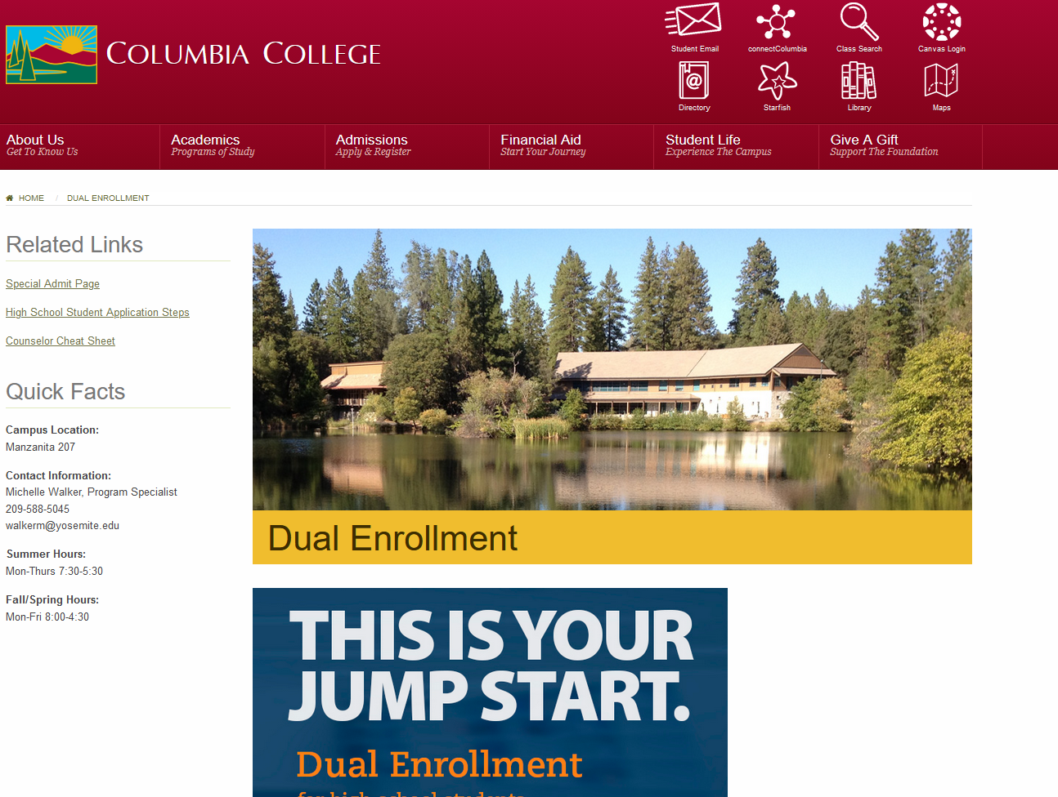
Online Resources
Link to Columbia College
Dual Enrollment Website

Slide 9
Online Resources
Dual Enrollment Toolkit
Link to Dual Enrollment Tool Kit
The Dual Enrollment Toolkit is a resource for secondary and community college partners. This resource will highlight and describe promising practices related to providing historically underrepresented high school students with opportunities to earn college credits at California Community Colleges (CCC) while they complete the requirements for their high school diplomas. The intent is to provide specific, concrete guidance and evidence to interested college administrators, faculty and staff who are planning to build partnerships with K12 districts to support dual enrollment efforts on their campuses and/or within their districts.

Slide 10
What is Dual Enrollment and Who Does it Work For?

Slide 11
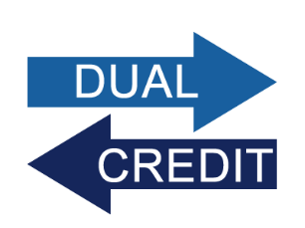
What is Dual Enrollment?
Dual enrollment offers students an opportunity to complete college-level coursework to earn college credits while they are pursuing their high school diploma.

Slide 12
Why promote Dual Enrollment Here?
Featured in an episode of the Educate podcast from APM (American Public Media)

Slide 13
Why Dual Enrollment?
Dual enrollment programs may offer a range of advantages to students including:
A chance to complete high school and college credits at the same time;
An introduction to and preparation for college life, expectations, and requirements;

Slide 14
Why Dual Enrollment?
A smoother transition from high school to college;
The ability to explore various careers and majors before enrolling in college full-time;
An opportunity to address skill gaps and improve study skills and academic knowledge before becoming a full-time college student;

Slide 15
Why Dual Enrollment?
Confidence in one’s ability to do college-level work and successfully pursue a postsecondary credential;
An accelerated pathway through college that saves students time and money

Slide 16
Does Dual Enrollment Work?
In fall of 2019 Columbia College had approximately 400 students who were dual enrolled. Why?
Dual enrolled students are more likely to go to college, have higher persistence, and higher completion rates than their peers.

Slide 17
Dual Enrollment at Columbia College
Middle College
2+2 Articulation
College and Career Access Pathway (CCAP) Partnership Agreements

Slide 18
Special Admits
Columbia College may admit students who are 14 years of age or older who would benefit from advanced scholastic or vocational work. To be eligible for admission, a student must be in good standing with the school in which he/she is enrolled and may not enroll in more than 11 units in any term. All applicants must submit a:
• Columbia College Admissions Application • Fee Waiver Application • High School Petition for Advanced Admissions • Health Services Consent Form
http://www.gocolumbia.edu/admissions/highschoolstudents.php

Slide 19
Early and Middle College
ECHS are small, autonomous schools that blend high school and college into a coherent educational program.
The legislation provides that a minimum school day for an ECHS student is 180 minutes
MCHS are secondary schools located on a college campus. These schools offer challenging academic programs designed to serve high-potential, high-risk students.
The legislation provides that a minimum school day for a MCHS student is 180 minutes

Slide 20
Early College
California Education Code (EC)Section 11302 declares that Early College High Schools (ECHS) are innovative partnerships between charter or non-charter public secondary schools and a local community college, the California State University, or the University of California that allow pupils to earn a high school diploma and up to two years of college credit in four years or less. ECHS are small, autonomous schools that blend high school and college into a coherent educational program.
ECHS facilitate a greater participation of at-risk, low-income, and students of color in college level courses. ECHS potentially decrease high school drop-out rates while increasing students’ access to post-secondary education. Students are rewarded for hard work by the opportunity to accelerate at typically minor cost to the student.

Slide 21
Early College
ECHS operated by school districts must offer at least 180 days of instruction per year. All students in grades 9-12 must be offered at least 64,800 instructional minutes each year. In addition, students must be scheduled for at least the minimum school day in order for a day to count as a day of instruction. EC Section 46146.5 exempts an ECHS operated by school districts from the 240-minute minimum school day requirement for students that are concurrently enrolled. The legislation provides that a minimum school day for an ECHS student is 180 minutes if the student is a special part-time student enrolled in a community college under specified provisions, or the student is enrolled in grades 11 or 12 and is also enrolled part-time in classes at California State University or University of California campuses.

Slide 22
Middle College
California Education Code(EC), Section11300 declares that Middle College High Schools (MCHS) have proven to be a highly effective collaborative effort between local school districts and community colleges.
MCHS are secondary schools located on a college campus. These schools offer challenging academic programs designed to serve high-potential, high-risk students. MCHS feature effective support services, small class size, and the opportunity for students to concurrently take some college classes at typically minor cost to the student.

Slide 23
Middle College
MCHS operated by school districts must offer at least 180 days of instruction per year. All students in grades 9-12 must be offered at least 64,800 instructional minutes each year. In addition, students must be scheduled for at least the minimum school day in order for a day to count as a day of instruction. EC Section 46146.5 exempts a MCHS operated by school districts from the 240-minute minimum school day requirement for students that are concurrently enrolled. The legislation provides that a minimum school day for a MCHS student is 180 minutes if the student is a special part-time student enrolled in a community college under specified provisions, or the student is enrolled in grades 11 or 12 and is also enrolled part-time in classes at California State University or University of California campuses

Slide 24
Early and Middle College FAQs
https://www.cde.ca.gov/ci/gs/hs/echs-mchsfaq.asp

Slide 25
CCAP agreements
College and Career Access Pathways (CCAP) partnership agreements enable high school students to take college courses on the high school campus during the regular school day. (AB 288)
“… can provide numerous benefits, such as reducing the number of high school dropouts, increasing the number of community college students who transfer and complete a degree, shortening the time to completion of educational goals, and improving the level of preparation of students to successfully complete for credit, college level courses.”

Slide 26
2+2 Articulation
2+2 articulation is designed to help students make a smooth transition from high school to college without experiencing duplication in learning. Students successfully completing an articulated course while attending high school can, upon enrolling at Columbia College, be awarded college units for that course and are released from pre-requisite requirements in sequential courses.

Slide 27
Considerations
CCAP programs were designed to encourage students who might not otherwise attend college to do so, selection processes need to be designed with this in mind.
Which students are good candidates for dual enrollment?
How do you promote success of dual enrolled students?

Slide 28
Thank You!

Slide 29
Dual Enrollment Resources
Dual enrollment toolkit:
http://www.careerladdersproject.org/ccccode/

Slide 30
Dual Enrollment Resources
Toolkit Includes:
• Dual Enrollment and Assembly Bill 288 (CCAP) – Legal Opinion 16-02
• AB 288 College and Career Access Pathways (CCAP) Partnership Agreement Apportionment Eligibility Checklist for Community College Districts
• Frequently Asked Questions
•Dual Enrollment: Considerations for AB 288 Agreements and Non-AB 288 Partnership
• AB 288 Partnership Agreement Framework
• Comparison of Non-AB 288 Agreements and AB 288 Partnership Agreements for Dual Enrollment
• Legal Table – California Education Codes and State Active Legislation Influencing Dual Enrollment as of January 26, 2016

